Slide 1

Funding rate Arbitrage-1
By: Cholian(cholian.chaoli@gmail.com)
Notes:
亮亮图文旗舰店https://liangliangtuwen.tmall.com

Slide 2
目录
CONTENT
What is the Crypto?
What is the Perpetual Future?
What is the Funding Rate?
How to do the arbitrage?

Slide 3
Feature | Cryptocurrency | Gold | Stocks | Bonds | ETFs
Nature | Digital or virtual currency | Precious metal | Ownership shares in a company | Debt securities | Funds that track an index, commodity, or other assets
Underlying Value | Based on supply, demand, and technology | Intrinsic value, industrial use | Company performance | Creditworthiness of issuer | Diverse, depends on tracked assets
Volatility | High | Moderate to low | Moderate to high, depending on stock | Low to moderate, depending on bond type | Varies, generally lower than individual stocks
Liquidity | High, but can depend on the cryptocurrency | High, widely recognized and tradable | High for listed companies | Varies, generally lower than stocks | High
Decentralization | Yes, for most cryptocurrencies | No, but not controlled by any single entity | No, subject to company governance | No, issued by governments or corporations | No, managed by an entity
Regulation | Low, varies by country | Highly regulated | Highly regulated | Highly regulated | Highly regulated
Use Case | Investment, speculation, transactions | Investment, hedge against inflation | Investment, dividends (for some) | Investment, interest income | Investment, diversification
Accessibility | High, available through online exchanges | High, through dealers, banks, ETFs | High, through brokers and exchanges | High, through brokers and exchanges | High, through brokers and exchanges
Security | Risks of hacking, requires secure storage | Physical risk (theft), requires secure storage | Company-specific risks, market risks | Credit risk, interest rate risk | Market risk, management risk
Return Potential | Very high, with high risk | Stable, historically preserves value | High, with variable risk | Lower, more stable returns | Varies, often aims for market-matching returns
What is the Crypto?

Slide 4
Q & A
Q: What is the difference over BTC, ETH, DOGE?
A:
Q: What

Slide 5
What is the Perpetual Contact?
Feature | Spot Trading | Options | Futures | Perpetual Contracts
Definition | Buying or selling an asset for immediate delivery. | Contracts giving the right, but not the obligation, to buy or sell an asset at a set price on or before a certain date. | Contracts obligating the buy or sell of an asset at a predetermined future date and price. | A type of futures contract without an expiry date, allowing positions to be held indefinitely.
Underlying Asset | Actual assets like cryptocurrencies, stocks, commodities. | Can be based on a variety of assets including stocks, indices, commodities, and cryptocurrencies. | Similar to options, can be on a variety of assets. | Often cryptocurrencies, but can be other assets as well.
Settlement | Immediate or near-immediate. | Can be settled at expiration or when exercised; physically or cash-settled. | Settled at future date; can be physically or cash-settled. | Settled regularly (often daily) via a funding mechanism, not at a set future date.
Leverage | Generally, leverage is not used or is low. | Leverage is inherent as a small premium can control a larger position. | High leverage is possible, as a margin is used to control a large contract value. | High leverage is available, similar to futures.
Expiration Date | Not applicable. | Yes, options expire on a specific date. | Yes, futures contracts have an expiry date. | No expiry date, allowing for perpetual trading.
Risk Level | Relatively lower risk compared to derivatives. | Potential loss limited to the premium paid, but can be complex and high risk. | High risk, as they can involve high leverage. | High risk due to leverage and market volatility.
Primary Use | Immediate trading or investment. | Hedging, speculation, or income (through selling options). | Hedging, speculation, or locking in prices. | Speculation, hedging, and leveraging positions without expiry constraints.
Profit/Loss Potential | Determined by the asset's price movement after purchase. | Limited loss (to premium paid), potentially unlimited profit. | Potential for high profit or loss, depending on contract terms and market movements. | Unlimited profit or loss potential, with regular settlement through funding rates to balance the market.

Slide 6
Examples
Trading Instrument | Scenario | Cost | Profit if Price Increases to $12,000 | Profit if Price Decreases to $8,000
Spot Trading | Buy 0.1 BTC at $10,000. | $1,000 (for 0.1 BTC) | $200 | -$200
Options (Call) | Buy a call option for 0.1 BTC at a strike price of $10,000 with a premium of $100. | $100 (premium) | $200 (Profit) - $100 (Cost) = $100 | -$100 (Premium paid)
Futures | Agree to buy 0.1 BTC in a month at $10,000. Margin required is $200. Assume futures price moves in tandem with spot. | $200 (Initial Margin) | $200 | -$200
Perpetual Contracts | Buy a perpetual contract for 0.1 BTC with a leverage of 10x. Initial margin is $100. Assume funding rates are negligible for simplicity. | $100 (Initial Margin for 10x leverage) | $2,000 (Profit from leverage) - Fees | -$2,000 (Loss from leverage) - Fees
Hypothetical Scenarios:
Asset: Bitcoin (BTC)
Initial Price: $10,000 (for all examples)
Price Increase: To $12,000
Price Decrease: To $8,000
Investment Amount: $1,000

Slide 7
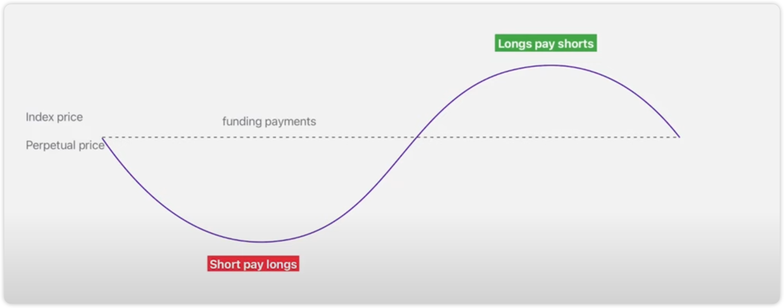
What is the Funding Rate?
https://www.binance.com/en/support/faq/introduction-to-binance-futures-funding-rates-360033525031
Pic sources: https://www.youtube.com/watch?v=fYncVOgQolg

Slide 8
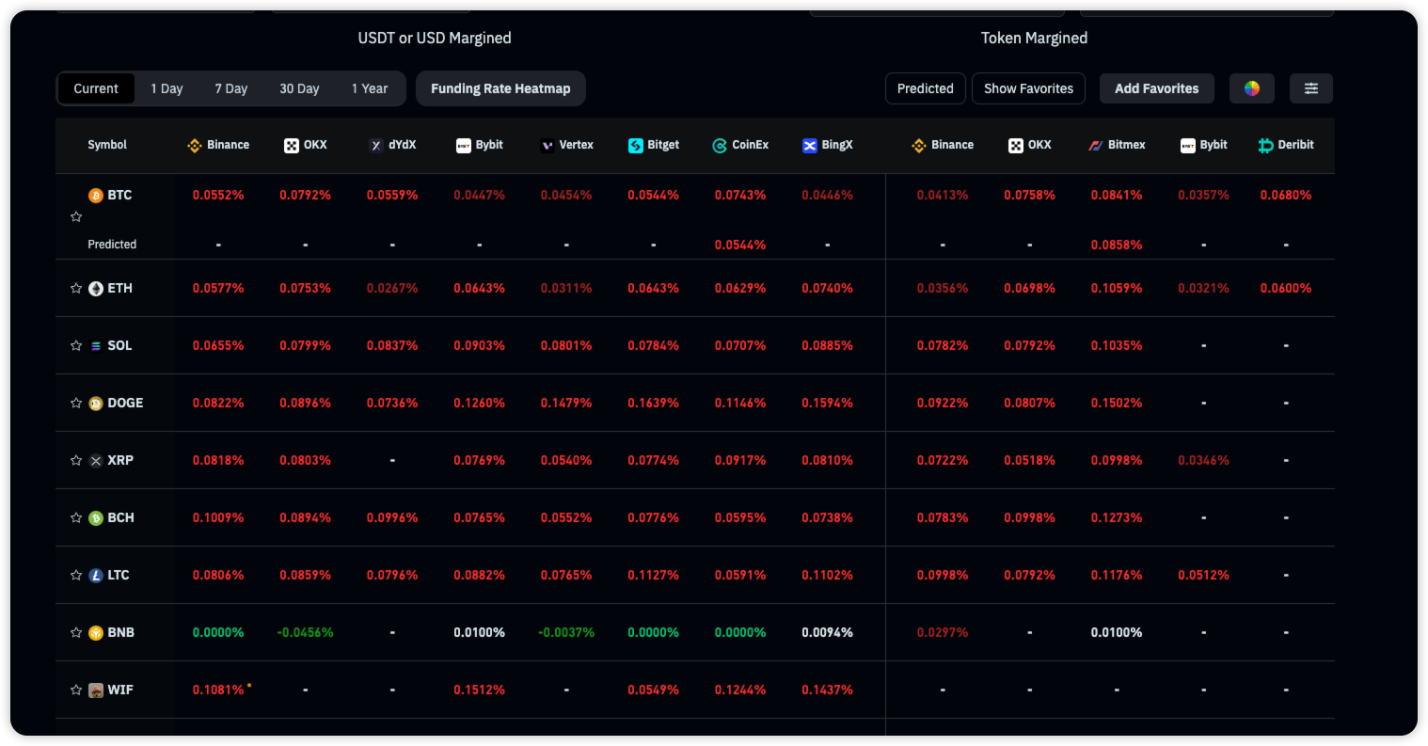
What is the Funding Rate?
Positive funding rate -> buyers (longs) pay sellers (shorts),
Negative rate -> shorts pay longs.
Funding payments with a settlement frequency of every eight hours start at 00:00 (UTC), 08:00 (UTC), and 16:00 (UTC).
Funding Amount = Nominal Value of Positions * Funding Rate
https://www.coinglass.com/FundingRate
https://www.binance.com/en/support/faq/introduction-to-binance-futures-funding-rates-360033525031

Slide 9
How to do the arbitrage?
Example 1
Hypothetical Scenario
Exchange A: The funding rate for BTC perpetual contracts is positive +0.10% every 8 hours.
Exchange B: The funding rate for BTC perpetual contracts is negative -0.05% every 8 hours.
Arbitrage Strategy
Open a Short Position on Exchange A
Open a Long Position on Exchange B
Let's say you invest $10,000 in each position:
Profit on Exchange A: +0.10% of $10,000 every 8 hours = $10.
Profit on Exchange B: -0.05% (you receive this because it's negative) of $10,000 every 8 hours = $5.

Slide 10
How to do the arbitrage?
Example 2
Hypothetical Scenario
Exchange X and Exchange Y both offer perpetual contracts for Ethereum (ETH).
On Exchange X, the funding rate for ETH perpetual contracts is positive 0.12% every 8 hours.
On Exchange Y, the funding rate for ETH perpetual contracts is positive 0.08% every 8 hours.
Short Position on Exchange X: By shorting ETH on Exchange X, you're positioned to receive funding payments from long traders at a higher rate.
Long Position on Exchange Y: To hedge against the market risk of the short position on Exchange X, you would take an equivalent long position on ETH on Exchange Y. Though you will be paying the funding rate here, it’s at a lower rate compared to what you're earning on Exchange X.
Example Calculation
If the arbitrage strategy involves positions of, say, $10,000 on each exchange:
Profit on Exchange X: +0.12% of $10,000 every 8 hours = $12.
Cost on Exchange Y: -0.08% of $10,000 every 8 hours = -$8.
Your net profit every 8 hours from the funding rate spread would be $4, assuming no other costs or losses.

Slide 11
Considerations? Risk?
Available pair with the highest funding rate spread.
Commission fee and profit calculation.
Risk management
Margin risk (price decreased so much)
Time risk (did not filled for both sides before the collecting time)
Order type
If Market order, how to avoid the slippage cost?
If Limit order, how to handle the unhedged positions?
(A exchange filled the order, rather than B)
Other risks

Slide 12
Homework:
Learn about the concept of the arbitrage.
1. Perpecture Future
2. Binance, Gate Open the account, deposit 100$
1. Earn one time for the fundingrate.
2. Know the leverage (Cross/Isolated)
3. setting your own API
3. Coding: CCXT, asyncio python / multiproceesing, typing, GitHub, CCXT pro
4. Spot vs Perpectural future arbitrage on funding rate
https://www.binance.com/en
https://www.gate.io/login

